Slide 1
Distributed Search
Lab

Slide 2
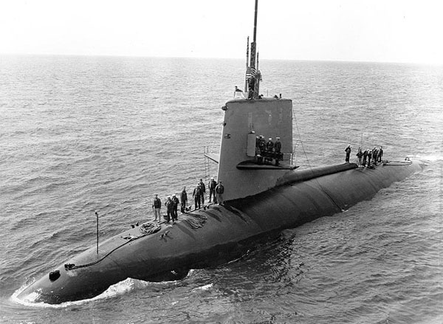
Search in Operations Research
Bayesian Methods*
  Deciding when an area has been searched enough.
Deterministic Algorithms
  Coastguard spirals
Examples:
  Nuclear submarine (scorpion, sank in 1968)
  atom bomb recovery (5 lost between 1950 and 1965)
  Wreck survivor recovery (single Heliocopter)
*Stone, Lawrence D. 1975. Theory of Optimal Search. Academic Press New York.
Search

Slide 3
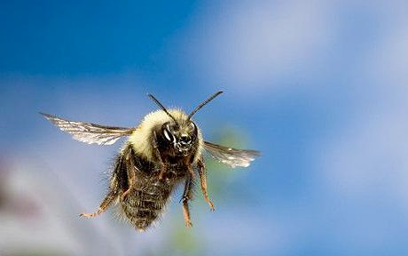
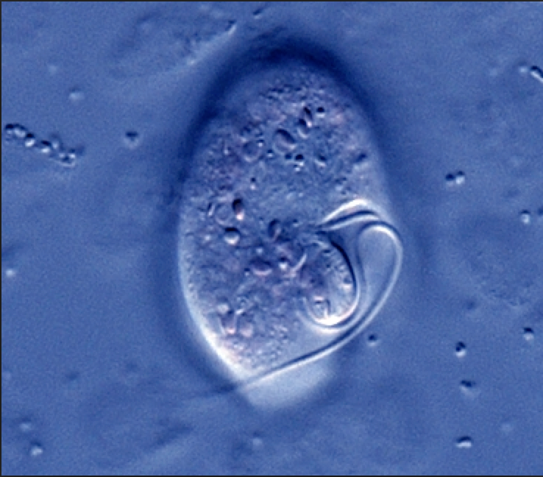
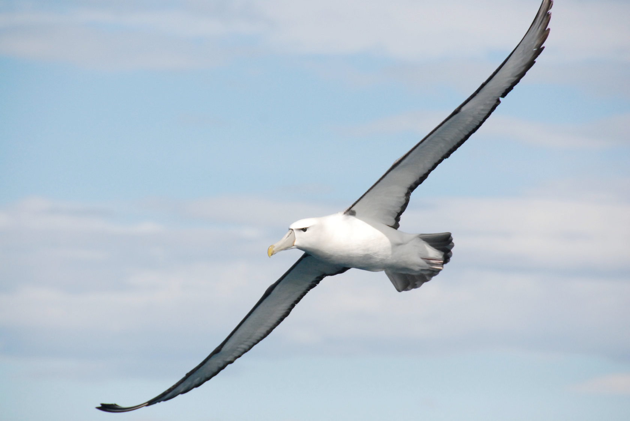
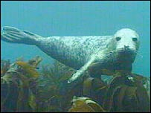
Search in Ecology
Foraging animals:
e.g.
Correlated Random Walks
Lévy walks
Méndez, Vicenç, Daniel Campos, and Frederic Bartumeus. 2013. Stochastic Foundations in Movement Ecology: Anomalous Diffusion, Front Propagation and Random Searches. Springer Science & Business Media.
Search

Slide 4
Lévy search
Ecology Example
Step Length Distribution:
Hausdorff Fractal Dimension:
Search

Slide 5
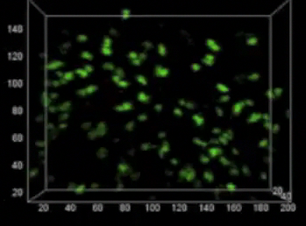
Immunology
The Needle in a haystack
DCs tagged with green dye.
T cells with red dye.
T cells must search a volume 10⁶ times their own volume at a mean velocity of .11 um/s.
To systematically explore the search zone would take 105 days.
T cells are able to find cognate antigen in about 8 hours and give up after 12-24 hours.
Krummel, M. F., Bartumeus, F., & Gérard, A. (2016). T cell migration, search strategies and mechanisms. Nature Reviews Immunology.
Search
Notes:
Each T cell is cognate to a particular antigen. DCs present antigen collected from periferal tissue.
24 hours is from Lythe’s how many T cells does it take paper.
Simon DeDeo mutual information of T cell locations and DC locations. Take the mutual information of the green and red channels.

Slide 6
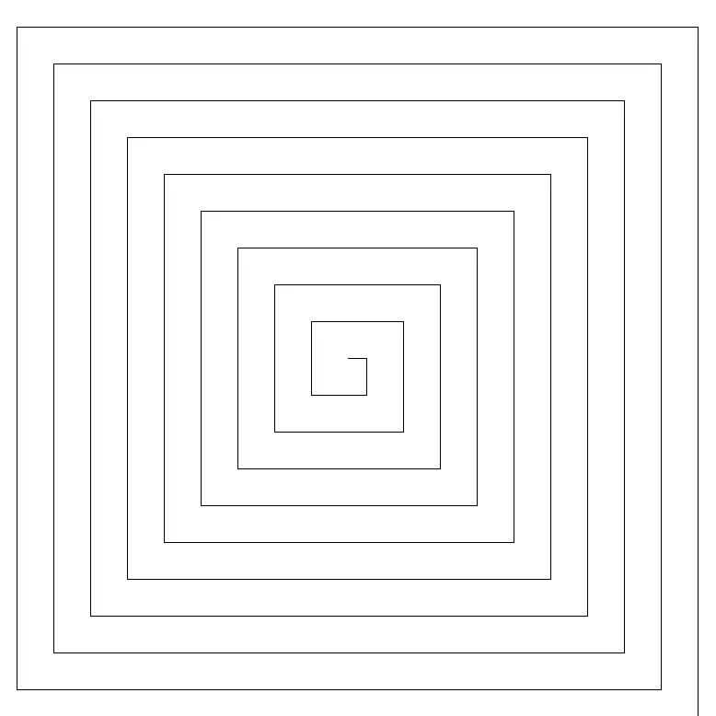
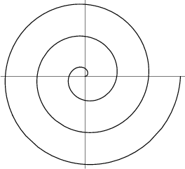
Deterministic Spiral Search
Archimedes Spiral
Square Spiral
To maximise search efficiency:
Find nearest targets first.
Square spiral minimises turns.
Minimise search extent.
Minimise oversampling.
Maximise coverage.
Search
Notes:
There is tension between minimising oversampling and complete coverage.
A spiral in which the “gap” is equal to a searchers detection diameter maximises coverage while minimising oversampling.
Ballistic motion maximises extent - spirals do not. They minimise extent conditional on not oversampling.
Turning precisely is harder for robots than linear motion. Coast guard flight manual appendix - search and rescue strategies for helicopters.

Slide 7
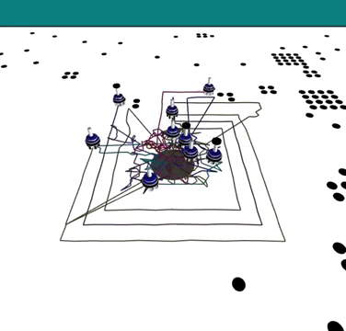
Distributed Spiral Search Algorithm (DDSA)
Argos3 Simulator
Black dots are targets
(Power law distribution)
Blue dots are robots
(Simulated iAnts)
Short detection
diameter but applies
to any distance.
Continuous plane
(no grid)
Defined by a simple
recurrence relation.
Search
Notes:
Argos3 simulator

Slide 8
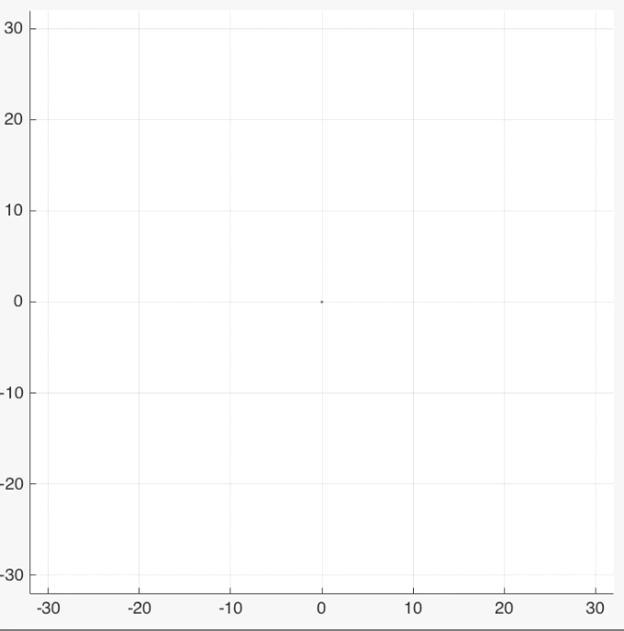
Interlocking Archimedes Spirals
Search

Slide 9
Lab: Random Search
1. Create a new project called epuck_brownian
2. Choose some x, y coordinate. This is your goal location.
3. Implement random search using 5 robots. When any of your robots get within 0.5m of the goal stop and display “Goal discovered” with the elapsed time in seconds and the ID of the robot in the log.
4. Your robots will alter course every max_step seconds. When altering course the robot will rotate a random amount between 0 and 2π.
5. When altering course the robot will rotate a random amount between 0 and 2π.

Slide 10
Lab: Random Search
1. Create a new project called epuck_levy
2. Choose some x, y coordinate. This is your goal location.
3. Implement Levy search using 5 robots. When any of your robots get within 0.5m of the goal stop and display “Goal discovered” with the elapsed time in seconds and the ID of the robot in the log.
4. Your robots will alter course probabilistically every n seconds where n is drawn from the a power law distribution with mu = 2.
5. When altering course the robot will rotate a random amount between 0 and 2π.

Slide 11
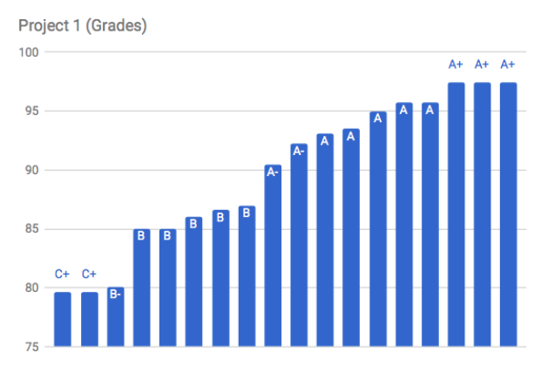

Slide 12
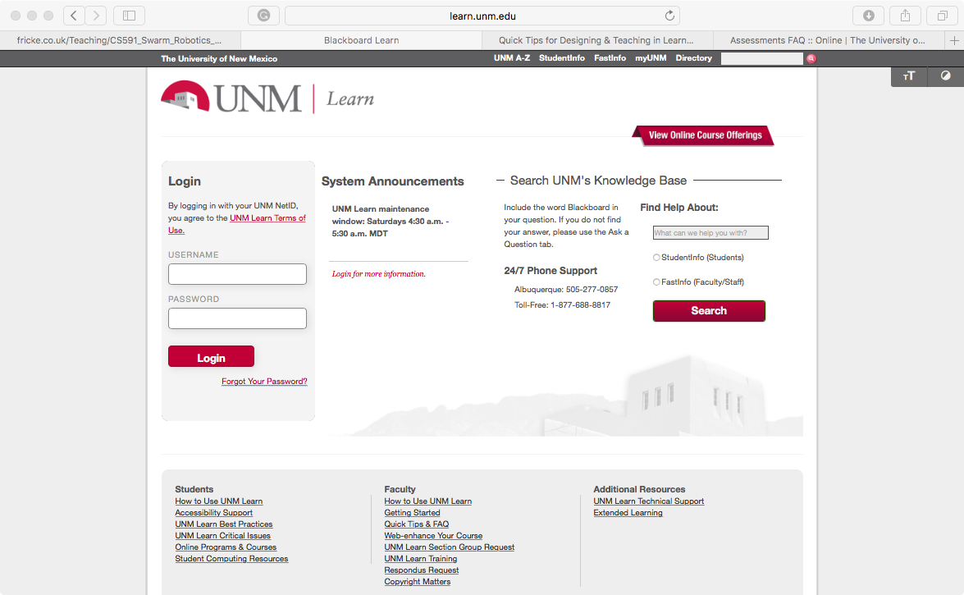

Slide 13
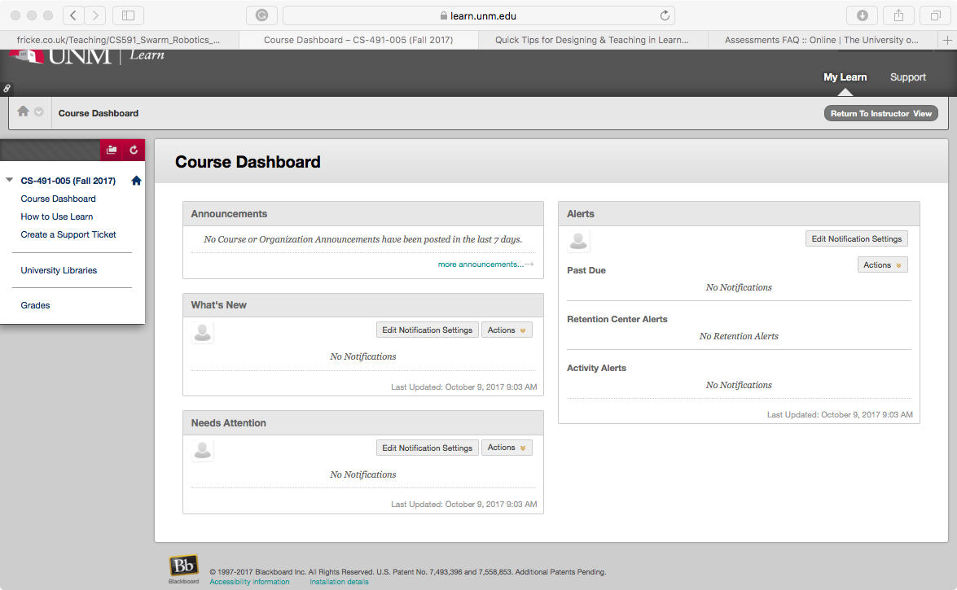

Slide 14
