Slide 1
Bug Algorithms

Slide 2
Approach
Insects have only local knowledge
Even Stygmergy is local in space, though perhaps not in time.
Simple robots have similar constraints
The class of Bug Algorithms require local knowledge to accomplish some task.

Slide 3
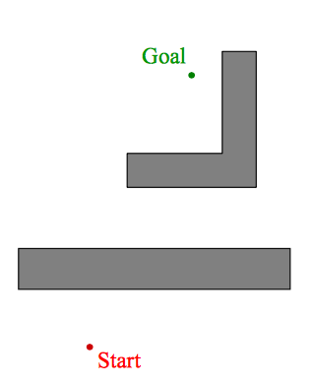
Bug Path Planning
Bugs know the direction to the goal (recall ants navigation via polarised light).
Bugs know the Euclidean distance between arbitrary points (not insect like).
Otherwise sensing is local (think range finders like an epuck and wheel encoders).

Slide 4
Bug 0
Algorithm:
Repeat
Head toward goal
While path to goal is blocked
Follow obstacle edges
End while
End Repeat

Slide 5
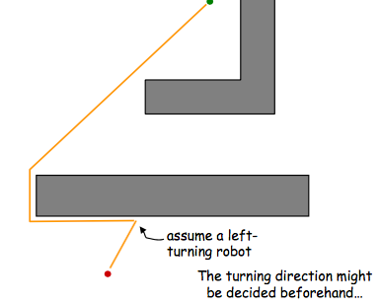
Bug 0
Algorithm:
Repeat
Head toward goal
While path to goal is blocked
Follow obstacle edges
End while
End Repeat

Slide 6
Design obstacles to break Bug 0

Slide 7
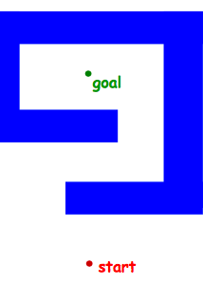
A Bug Trap
Algorithm:
Repeat
Head toward goal
While path to goal is blocked
Follow obstacle edges
End while
End Repeat

Slide 8
Bug 0
The problem with Bug 0 was that is had no way to back track
Need to add some memory to the robot

Slide 9
Bug 0
The problem with Bug 0 was that is had no way to back track
Need to add some memory to the robot

Slide 10
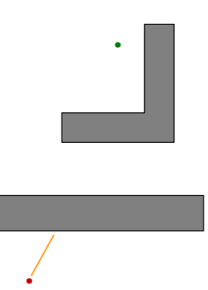
Bug 1
Algorithm:
Repeat
Head toward goal
While path to goal is blocked
x := point where the obstacle was encountered
do
Follow obstacle edges all the way round
n := the minimum distance to the goal
while not back at x
go to n
End while
End Repeat
Lumelsky, V.J. & Stepanov, A.A.

Slide 11
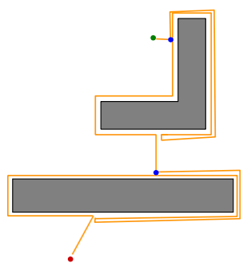
Bug 1
Algorithm:
Repeat
Head toward goal
While path to goal is blocked
x := point where the obstacle was met
do
Follow obstacle edges all the way around
n := the minimum distance to the goal
while not back at x
go to n
End while
End Repeat
n
x
n
x
Lumelsky, V.J. & Stepanov, A.A.

Slide 12
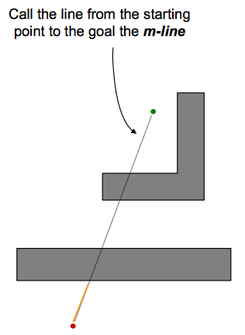
Bug 2

Slide 13
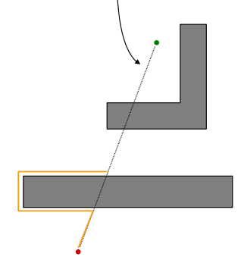
Bug 2
Algorithm:
While not at the goal
Follow the m-line
While path to goal is blocked
Follow obstacle edges
If m-line met then break
End While
End While

Slide 14
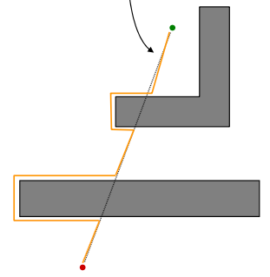
Bug 2
Algorithm:
While not at the goal
Follow the m-line
While path to goal is blocked
Follow obstacle edges
If m-line met then break
End While
End While

Slide 15
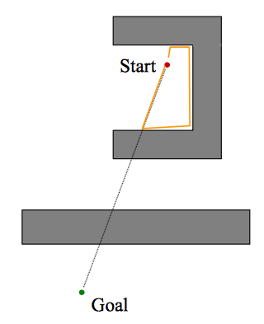
Debugging: Bug 2
Algorithm:
While not at the goal
Follow the m-line
While path to goal is blocked
Follow obstacle edges
If m-line met
then break
End While
End While
What went wrong?
What’s the fix?

Slide 16
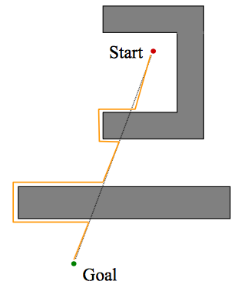
Bug 2
Algorithm:
While not at the goal
Follow the m-line
While path to goal is blocked
Follow obstacle edges
If m-line met closer to the goal
then break
End While
End While
Orange: Right Turning, Blue: Left Turning

Slide 17
Bug 1 vs Bug 2

Slide 18
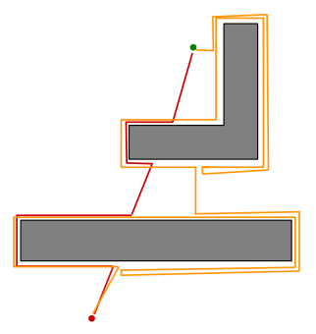
Bug 1 vs Bug 2

Slide 19
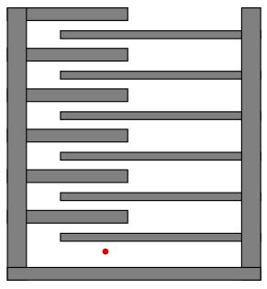
Bug 1 vs Bug 2

Slide 20
Bug 1 vs Bug 2
Bug 1: Is exhaustive. Considers all choices
before progressing.
Bug 2: Is a greedy algorithm.
Takes the first thing that looks better.
Bug 2 will often outperform Bug 1,
but is less predictable.

Slide 21
Tangent Bug

Slide 22
Tangent Bug

Slide 23
References
Robotic Motion Planning: Bug Algorithms, H. Choset, G.D. Hager, and Z. Dodds, Carnagie Mellon University, Robotics Institute 16-735
Lumelsky, V.J. & Stepanov, A.A., “Path-planning strategies for a point mobile automaton moving amidst unknown obstacles of arbitrary shape”, Algorithmica (1987) 2: 403

