Slide 1
Distributed Coordination Algorithms for Mobile Robots Swarms: New Directions and Challenges
Paper by David peleg
Presentation by Vanessa surjadidjaja

Slide 2
Overview
What is a robotic swarm?
Types of coordination algorithms
Coordination algorithm results
Mods and Future Experiments

Slide 3
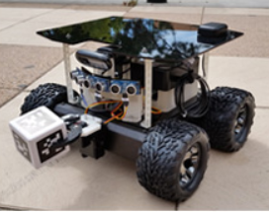
Robotic Swarms
Cost-efficient to build
Easy to replace if damages occur
Simplistic and limited in:
Energy resource
Communication
Processing power
Nasaswarmathon.com

Slide 4
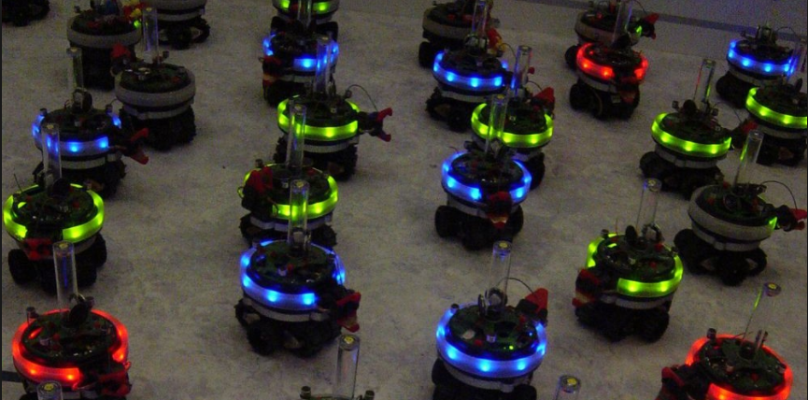
Coordinated Algorithms
Coordinated Movement:
Gathering
Convergence
Pattern Formation
Flocking
Additional Coordination Tasks:
Partitioning
Spreading
Exploration
Mapping
Patrolling
Searching
Obstacle avoidance
Avoiding bottleneck
fondation.ulb.ac.be%2Fen%2Fswarm-intelligence-robotics-dorigo

Slide 5
Coordinated Algorithms
Robot operation cycle:
Look: identify location or other robots.
Compute: execute algorithm.
Move: taxis towards a point.
Synchronization model:
Semi-synchronous: robots operate on the same clock cycles, but not all robots are active during all the cycles.
Asynchronous: each robots acts independently and can be at different states of the cycle: wait, look, computer, and move.
Synchronous: all robots operate on the same clock cycle and all robots are active in all cycles.

Slide 6
Coordinated Algorithm Results
Many studies have focuses on identifying the minimal capabilities a swarm of robots must have to successfully complete a basic task.
These studies have shown mixed results with regards to the success rate of the swarm.
Suzuki and Yamashita found that in a semi-synchronous model, 2 oblivious robots cannot be gathered without common orientation.

Slide 7
Modding the Robot Model
As of 2005, most of the literature focused on the behaviour of oblivious robots (e.g. no coordinate system, orientation, scale, compass, and “no means of explicit communication”)
Equipping robots with a small amount of stable memory allows for the simplification of robot coordination algorithms.
Robots can recognize their computational phase.

Slide 8
Modding the Robot Model
Including common orientation.
E.g. using a common point of reference or establishing North.
Explicit means of communication.
Can solve coordination problems.
Means of identification and signaling.

Slide 9
Future Exploration
How do we discard the assumption of infinite precision and instead rely on approximation?
Peleg suggests the “relaxations in the definitions of certain common tasks.”
Enhanced fault tolerance through redundancy.
A model with Byzantine faults makes gathering tasks almost impossible (or result in high complexity).
How do we avoid Byzantine faults among swarm robots?

Slide 10
Reference
D. Peleg. Distributed Coordination Algorithms for Mobile Robot Swarms: New Directions and Challenges. LNCS 3741, 1-12 (2005).

