Slide 1
Review of “From Fireflies to Fault-Tolerant Swarms of Robots” by Christensen, O’Grady, Dorigo
Presented by Akil Andrews

Slide 2
Introduction
Seek “robust, simple, decentralized” [1] fault detection paradigm for robot swarms
Once detected the swarm can replace or repair non-functional robots
Problem: Carlson [2] research MTBF 24hours
Goal: Present an exogenous approach that allows a robot swarm to detect faults using local information
Notes:
Carlson tested 15 mobile robots from 3 different companies over 3 years and found MTBF 24 hours
Add to this, the swarm philosophy of simple cheap robots
Exogenous robots detect faults in other robots vs endogenous self fault detection
Endogenous is not as robust for multirobot systems - complexity - software hardware faults that render robot unable to alert
Reminder that swarm design relies on self-organization through local interactions lead to scalability, inherent parallelism, and robustness

Slide 3
Related Work
Swarm - fault tolerance emerging from simple adaptive controller design
  Winfield and Nembrini
  Lewis and Tan – control algorithm for maintaining geometric formations
Non-swarm – small number of tightly coupled and/or centralized collection robots
Notes:
Since we are interested in swarms, tightly coupled and centralized approaches have serious scalability problems
Goal to find an approach to fault detection that scales up with simple robots, decentralized using local information
Key word local information

Slide 4
Hardware
Swarm-bot aka s-bot by Francesco Mondada’s group
Used in several studies
Specs:
  400MHz CPU
  Omni camera
  Light sensors
  Proximity sensors
  Gripper
  8 LEDs 360 ring
Program: sense, think, act (0.15s)
Notes:
S-bot used several swarm intelligence and collective robotics experiments
Gripper supports physical connections, collectively move heavy objects or move together up inclines
Each cycle period 0.15s program reads sensor data, processes data, sends control signals

Slide 5
Hardware cont’d
Omnidirectional camera
Does not use actuators or controllers. How?
mirror
camera
Notes:
Omnidirectional camera full 360 images achieved by
Camera is located at base of a transparent Perspex tube
At the top is a hemi-spherical mirror
Images are divided into multipixel blocks and its configured to detect the location of the colored LEDs of s-bots and discard all other information

Slide 6
Detecting Faults
How can robots detect faults?
Communication medium: Radio, Sound, Visual color-based
Problem: both radio and sound are abstract
Solution: visual is situated
Notes:
Answer: send out periodic signals saying I am operational, absence of signal identifies non-operational robots
Abstract means robots that receive the message are unable to determine the location of the sender relative to their own frame of reference
Thus messages are separated from environment localization information which drive self-organization
Radio - short distance radio comm using directional antennas
Sound -multiple microphone using sound delay estimates
Expensive and not simple (swarm philosophy)
Visual is implicitly situated – detect changes in led colors by analyzing images in own frame of reference

Slide 7
Detecting Faults cont’d
Visual options researched:
Unsynchronized Flashing Protocol
Ping-Pong Protocol
Synchronized Flashing Protocol
Problem: How to flash periodically at the SAME time?
Notes:
Unsynchronized e.g. red for 2s green for 2s then red then green etc. – robot not flashing or has constant color = fault
-Requires continuous monitoring of neighbors to keep track of individual robots is computationally expensive to image processing
Ping Pong e.g send ping, stop motion, wait for pong – robot does not pong = fault
-Responding to multiple pings will keep robot illuminated green would could be false positive for fault
-Or a functional robot may not pong if it becomes obfuscated
Synchronized e.g. robots change color together – any robot not flashing on wrong color = fault
-No need to identify and track neighbors, failed neighbor detected on single image capture
-Nature provides and elegant solution – fire flies

Slide 8

Visual Synchronization in Nature
Notes:
A lot of research in paper done on synchronization to support fault detection,… not much about fireflies exactly
Fireflies use coupled oscillation with synchronous behavior
Non-visual examples of coupled oscillating systems with synchronous behavior: cardiac cells, grasshoppers, and clapping/cheering
But we want visual
Picture of large groups of tropical fireflies, river banks in southeast asia that spontaneously synchronize their flashes

Slide 9
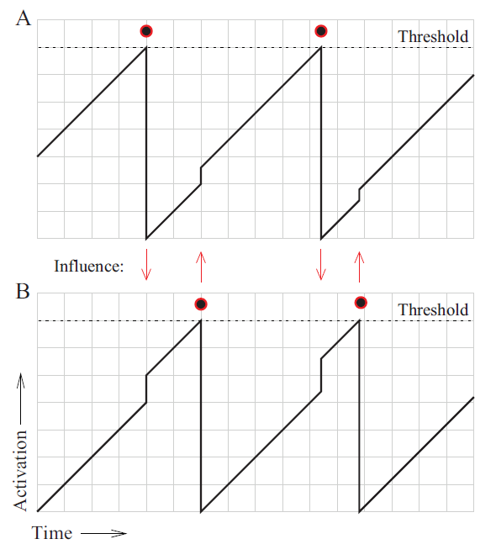
Visual Synchronization in Nature cont’d
Classes of oscillators:
  Continuously influence one another
  Influence during short periodic pulses
This experiment uses the latter: pulsed-coupled oscillator => synchronization
Notes:
Short periodic pulses
-when a nearby oscillator observes a flash, increases activation by small amount, exceed threshold fires, resets activation to zero, cycles
From research pulsed-coupled oscillators lead to self-synchronization
-Mirollo and Strogatz [40] showed that a population of fully connected pulse-coupled oscillators almost always evolve to all firing synchronously
-Lucarelli and Wang [41] showed even with subset interactions that groups will eventually sync

Slide 10
Robot Synchronization – Physical and Simulation
When activated robot flashes red LEDs
When neighbor robots detect they increment activation
To handle the discrete behavior of sense-think-act use a discrete model with piece-wise linear dynamics
Time between flashes of an isolated robot = 15s
Synchronization defined as all activations within 1/15s
Notes:
Latency in robot control between sending signal and led flashes
Latency in camera image processing
Compensated by keeping LEDs flashing for 0.75s, so a robot can perceive a flash while flashing itself

Slide 11
Robot Synchronization – Simulation
Experiments limited to two pattern of movement:
  Random walk
  Static position
Both start with random positions and orientations
Notes:
For static positions, randomly positioned until connected interaction graph achieved

Slide 12
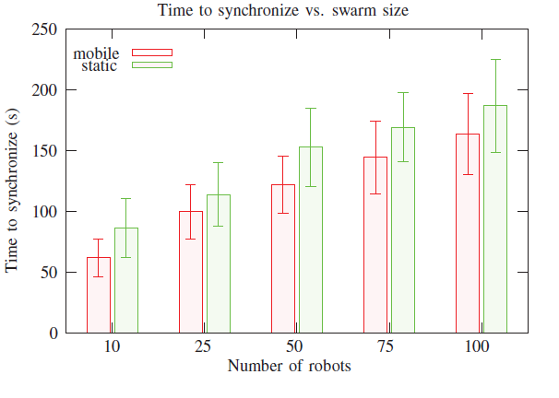
Robot Synchronization – Simulation cont’d
Notes:
Time to sync vs swarm size 10, 25, 50, 100
We see a nice linear relation
Larger swarm takes longer to sync
Mobile syncs faster than static
Bar mean sync time in 100 replications, error bar = standard dev

Slide 13
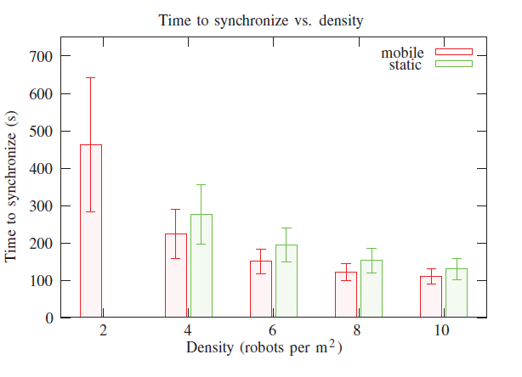
Robot Synchronization – Simulation cont’d
Notes:
Time to sync vs density using 50 robots, 2, 4, 6, 8, 10 robots/m2
Denser swarm shorter time to sync, more robots within sensor range
Mobile syncs faster than static
Bar mean sync time in 100 replications, error bar = standard dev

Slide 14
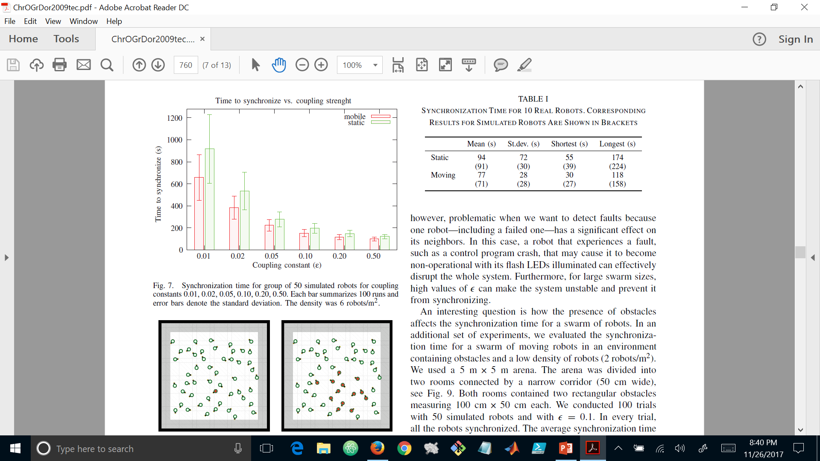
Robot Synchronization – Simulation cont’d
Notes:
Time to sync vs a coupling constant
Coupling strength between robots, in discrete model formula with piece-wise linear dynamics, would require better hardware, stronger sensors leds?
Controls strength of each interaction, if too high a single robot in fault could lead neighbors to flash too soon and for large swarms prevent full sync
Bar mean sync time in 100 replications, error bar = standard dev
6 robots/m2

Slide 15
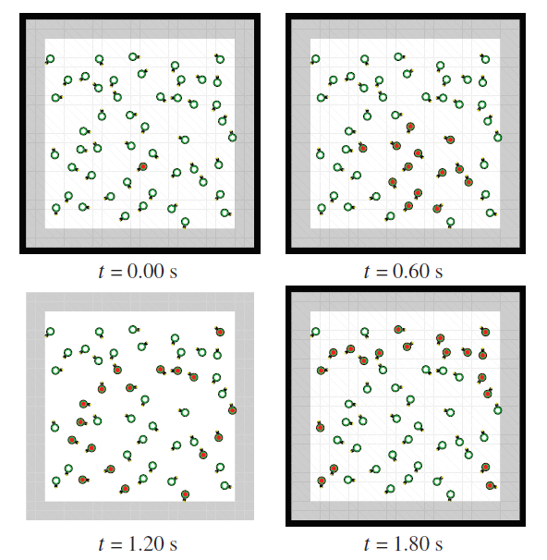
Robot Synchronization – Simulation cont’d
Notes:
Static robots would experience waves of sync before reaching full sync
No waves if perceive and response instant, because all would flash
Waves are due to programmed latencies of turning on led, image processing, image capture
Static robots have similar activation values when flashes propagate in waves
Moving robots speed up sync by reaching more robots so you don’t get nice waves prior to full sync

Slide 16
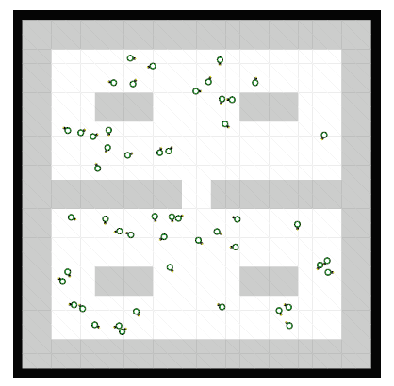
Robot Synchronization – Simulation cont’d
Notes:
Sync with obstacles, moving robots, initial density 2 robots/m2, 100 trials, 50 robots, coupling = 0.1
Swarm always synced, average time 779s vs no obstacles 462s, so swarm can sync even with obstacles just more time like winfield

Slide 17
Robot Synchronization – Physical
10 physical robots
4 robots/m^2
Assigned random initial activations
10 trials
Notes:
Replicated 10 times versus 100 in simulation, even so the real data is quite similar to simulated data
Noticed same trends: moving sync faster than static
Robots did sync in all experiments
So although given discrete nature of sense-think-act and latency of sensor/actuators, pulsed-coupled oscillator real robots always sync… amazing

Slide 18
Fault Detection
Swarms can use synchronization for exogenous fault detection
Self reporting
Control program fails
Given the detection swarms can respond accordingly
Notes:
Robot can stop flashing if it determines it is in a fault state
If the program crashes, then flashing will definitely impact periodic flashing
Once detected swarms can replace or repair

Slide 19
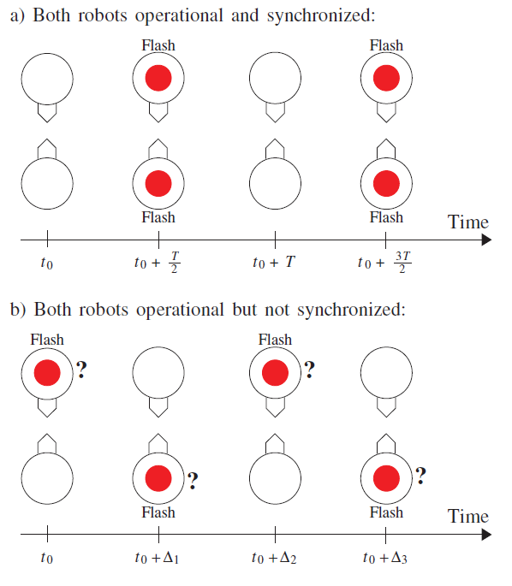
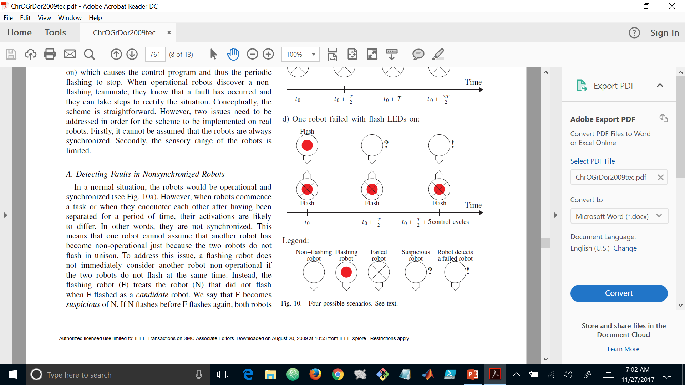
Fault Detection cont’d
Robots operational but not synced
Notes:
Two issues need to be addressed for successful fault detection using visual synchronization
First robots are not always synchronized as you can imagine so how to handle and sensor and emitters have limited range
When doing tasks and moving in and out of range robots activations are likely different, not flashing in unison
3 cases, let robot A = top robot B = bottom
Case 1. So robot A see’s robot B not flashing robot, robot A becomes suspicious and marks robot B as a candidate? Then robot B flashes but does not see A flash now robot B becomes suspicious and marks A as a candidate. As long as each robot continues to flash before the other, they remain suspicious but do not report fault detection

Slide 20
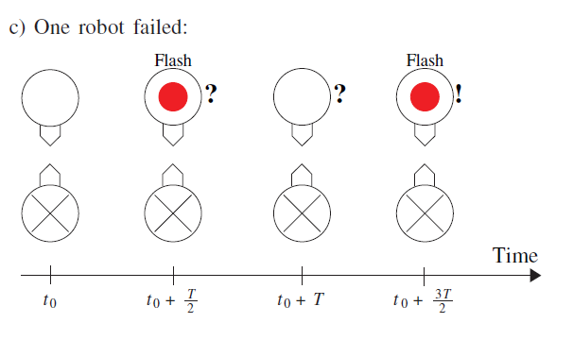
Fault Detection cont’d
Robot failed
Notes:
Case 2 . If robot A flashes twice while robot B does not flash at all, robot A moves robot B from candidate to fault detected
The figure does not show but there is a rare condition where one robot can flash twice while the other does not flash although both are operational. This happens when they are both very close to sync, flash, flash, and one robot gets more excited by other robots and flashes again, so it detects two flashes with no response. The experimenters added a delay calculation based on knowing how much the robot flashes excite each other alone. If robot A calculates it has excited robot B enough then I detects a fault, otherwise it has to wait for its next flash which should excite robot B to flash before detecting fault

Slide 21
Fault Detection cont’d
Robot failed with lights still on
Notes:
Case 3. robot B has failed and in a state where the LEDs are constantly on. Recall flash duration is 5 control cycles or 0.75s. And time between cycles is T = 100 cycles or 15s. So robots are programmed to consider any robot still flashing after it is half way excited to be a candidate. And if that candidate robot is still flashing after 5 control cycles a fault is detected.

Slide 22
Fault Detection cont’d
Robot failed with lights still on
Notes:
The second issue that needs to be addressed for successful fault detection using visual synchronization is that sensor and emitters have limited range
Robots while moving can come in and out of sensor range
Experimenters didn’t use hack for ID’ing robots, as some of us did for 6 Argos experiment ;)
So the robot is programmed to stop when it becomes suspicious of another robot. The experimenters make a huge assumption that a faulted robot stops movement. So I’m guessing they also programmed the robots to halt when anything stops working.
This programming to halt robots has time delay effects when a swarm is initially launched to do a task, since randomly set and out of sync they are all suspicious of each other. So basically every robot is halting and no tasks are being completed.

Slide 23
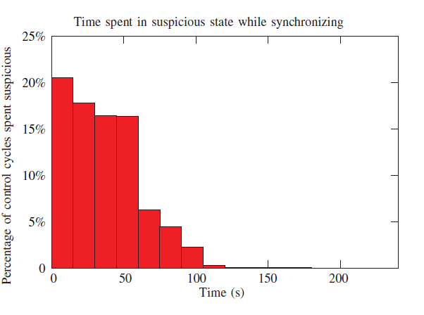
Fault Detection cont’d
Limited sensor range
Notes:
The second issue that needs to be addressed for successful fault detection using visual synchronization is that sensor and emitters have limited range
Robots while moving can come in and out of sensor range
Experimenters didn’t use hack for ID’ing robots, as some of us did for Winfield Argos experiment ;)
So the robot is programmed to stop/halt when it becomes suspicious of another robot.
The experimenters, for simplicity, make a huge assumption that a faulted robot stops movement, hence it can be observed.
This programming to halt robots has time delay effects when a swarm is initially launched to do a task, since randomly set and out of sync they are all suspicious of each other. So basically every robot is halting and no tasks are being completed.
This chart shows the initial time overhead of the stop-while-suspicious strategy during the beginning of a sample run.
One solution suggested was a warm up period of in this case 120 but that has a tradeoff adding more latency to fault detection.

Slide 24
Experiments with Physical Robots
Fault detection experiments
10 physical robots
Robots constantly emit a green LED to be visible by other robots for obstacle avoidance
Robots perform random walks
Robots can repair one another
Started by letting the robots synchronize and then simulate a fault in one robot
Notes:
Conducted 10 experiments measuring time to detect a failed robot
Repair by physically connecting and transporting failed robot to a repair zone
The simulated fault was complete motor and sensor failure

Slide 25
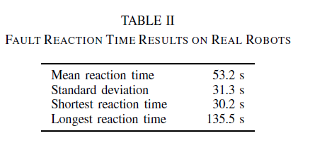
Experiments with Physical Robots cont’d
Notes:
Table shows time for robots to detect fault and connect to failed robot for transport to the robot hospital
The fault was correctly detected in all 10 experiments fault was correctly detected
Mean time 53.2s for detection and connecting to fault robot for extraction
The shortest time 30.2s occurred because the fault detecting robot was in close proximity to the failed robot
The longest time 135.5s because the initial robot that detected the fault failed to connect for transport, another robot detected the fault and moved in, hence robustness of swarm ;)
And interestingly enough 1 robot hardware i/o and treels/LED actuators actually failed

Slide 26
Experiments with Physical Robots cont’d
Fault tolerance experiments
10 physical robots
Fault injected in each robot probability = 0.0005 per cycle
A total of 13 faults occurred
Robots can repair each other (simulated)
Notes:
Repair simulate by once connected instead of transporting robot turns blue for 15s
Once repaired the once dead robot is reinitialized.
Experiment ran for 12 mins
First fault occurred after 20s
Again, one robot experience a real failure so once the simulated repair was done they removed it from the arena
And they manually picked up a robot that collided and toppled over… I guess obstacle avoidance failed interesting given that they can only see green light emitting objects

Slide 27
Questions

Slide 28
References
[1] A.L. Christensen, R. O’Grady, and M. Dorigo. “From Fireflies to Fault-Tolerant Swarms of Robots” in IEEE Transactions on Evolutionary Computation, Vol. 13, No. 4, August 2009

